Slide 1
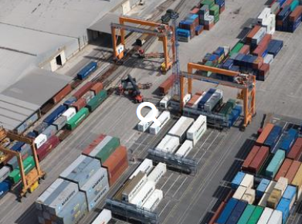
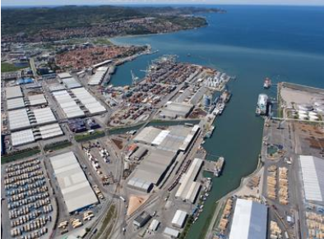
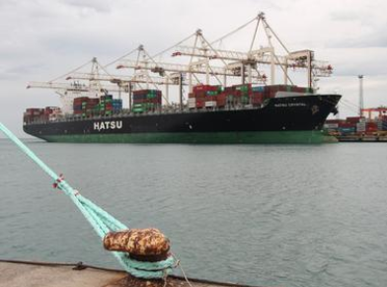
Migrating to UN/EDIFACT Standard
Benchmarking with other terminals
Koper, Slovenia - 9th June, 2015

Slide 2
Who am I ?
Finn W. Jensen

Slide 4
Before we start
W I I F M

Slide 5
Before we start
What is in it for me ?

Slide 6
Scope
Benchmark Summary
EDIFACT Benefits
Our Recommendation
6
Notes:
6

Slide 7
Scope
7
Notes:
7

Slide 8
S C O P E
Benchmark of four ports
Bremerhaven, La Spezia, PD Ports, Ports of Auckland
Gate-in & Gate-out for rail, truck & vessel – EDI focus
Operational Process & Communication Analysis
GAP analysis on Best Practices
What are the other ports doing?
Will this be a benefit for the supply chain?
The Benefits
What will COPARN/COREOR deliver of benefits?
The Optimal Solution
The necessary changes
UN/EDIFACT Guidelines & minimum data requirements
Deviations from standards – the “What-if”s
8

Slide 9
Benchmark
9
Notes:
9

Slide 10
The 21 Questions
Which UN/EDIFACT messages are being used?
Does the terminal handle non-standard EDI?
Do they use EDI Implementation Guidelines
Do they have EDI partnership contracts
Which TOS and other systems do they use?
How does the terminal convert EDI to TOS format?
How are EDI messages received and sent?
How are EDI messages stored?
Does the terminal use a VBS?
How is rail in/out information managed?

Slide 11
The 21 Questions
Are gate-in moves checked against pre-advices (COPARN)?
How are the load- and discharge lists checked?
Are they sending of gate-in/out and load/discharge moves?
How are import containers released by the lines (COREOR)?
How is the “PIN” validated at the gate (COREOR)?
Are they validating other holds and stops?
Does the terminal use Process Documentation?
Do we have access to any process documentation?
Do the terminals apply Quality Management?
Which Shipping Lines does the terminal serve?
Are there any lines that cannot manage UN/EDIFACT?

Slide 12
Benchmark Result
All terminals use
UN / EDIFACT standard messages & Guidelines (but also handle non-standard messages from lines that cannot do EDIFACT)
EDI management in either TOS, PCS or separate system.
Communication via e-mail + attachments or the PCS
Gate-in FCL export validation against COPARN
Gate-out FCL import validation against COREOR + PIN (PD Port manages import via the PCS updated by line operator)
PCS = Port Community System
BPM = Business Process Management and documentation
TOS = Terminal Operation System – Navis N4 / XPS
VBS = Vehicle Booking System
ISO Certification (three)
12

Slide 13
Terminal use of EDIFACT
 | BAPLIE IN | BAPLIE OUT | MOVINS | COPARN | COPRAR | COARRI | CODECO | COREOR
BRV | Yes | Yes | Yes | Yes | Yes | Yes | Yes | Yes
LSCT | Yes | Yes | Yes | Yes | Yes | Yes | Yes | Yes
PDP | Yes | Yes | Yes | Yes | Yes | Yes | Yes | Yes
PoAL | Yes | Yes | Yes | Yes | Yes | Yes | Yes | Yes

Slide 14
Terminal use of VBS
 | Vehicle Booking System
BRV | Yes – Pre-advises are managed by the TOS
LSCT | Yes – Pre-advises are managed by the TOS
PDP | We have licensed VBS but not implemented it as yet
PoAL | Yes, 1-Stop is used to manage traffic through the gates.

Slide 15
Terminal use of COPARN
 | Gate-in checks
BRV | Yes. Units are checked against COPARN.
LSCT | Yes. Units are checked against COPARN which is mandatory to gate in.
PDP | Yes, via COPARN in Port Community System MCP
PoAL | Yes, the TOS checks the VBS pre-advice against the COPARN. For pre-advised containers the trucker uses a gate-kiosk and enters a PIN to get auto-access to the terminal, based on information entered by the trucker into 1-stop and validated against the COPARN.

Slide 16
Terminal use of COREOR
 | Terminal check of the PIN
BRV | COREOR “PIN” checked at the gate
LSCT | COREOR “PIN” at gate plus driver name/truck plate
PDP | All releases are via Port Community System “PIN”
PoAL | COREOR “PIN” checked at the auto-gate. Some lines allow release against customs release, where the release certificate is scanned and the release number recorded. Direct access to the PCS is allowed for shipping lines to enter their own “PIN”.

Slide 17
Terminal Customers
 | List of shipping lines
BRV | UNIFEEDER, TRIMODAL, HAPAG-LLOYD, MSC, OLTMANN, MAERSK, MANNLINES, OOCL, KLINE
LSCT | Australian National Line, CMA-CGM, Cosco, China Shipping, BRO Intermed, Evergreen, Hamburg Sud, COSCO., Hapag Lloyd, MSC, Maersk Line, NYK, OOCL, Mitsui OSK, UASC, Yang Ming, Wilhelmshaven Lines
PDP | MSC, CMA-CGM, Kline, BGF, Containerships, McAndrews, A2B, Maersk, NYK, APL
PoAL | Australian National Line, CMA-CGM, Hamburg Sud, COSCO., Hapag Lloyd, MSC, Maersk Line, NYK, OOCL, Pacific Forum Line, Pacific International Line, Wilhelmsen Lines, Mitsui OSK

Slide 18
EDIFACT Benefits
18
Notes:
18

Slide 19
Benefits
COPARN gate-in announcement
Pre-check of details prior to delivery
COREOR gate-out release
Secure release process with PIN
Gate-in/out Management benefits
Better load/discharge/decking planning
Less terminal household moves
Faster truck turn-time combined with VBS
Less discrepancies during gate-in/out
Reduced truck pile-up at the gate

Slide 20
V B S ?
Vehicle Booking System

Slide 21
VBS
21

Slide 22
Recommendation
22
Notes:
22

Slide 23
Recommendation
Initial prioritization
Cost/benefit/impact analysis
Tideworks TOS review
Development timeline
Business workshops and pilots
Development Program
23

Slide 24
Q & A
Vector Port and
Transport Solutions
UK OFFICE
Tel: +44 1452 550 292
Mob: +44 777 569 4916
Fax: +44 700 603 5379
Email: info@vectorpts.co.uk
BRAZIL OFFICE
Tel: +11 3 382 1461
Mob: +11 9 823 9928
Email: e.gedeon@vectorpts.co.uk
Web: www.vectorpts.co.uk
24

Slide 25
“What-if” scenarios
25
Notes:
25

Slide 26
“What-if” Scenarios
Pre-check cannot be done due to missing COPARN and/or DA/VBS.
The COPARN and/or Rail Manifest have not been received
The GOLDEN RULES
Always verify the information received and ask for a message to be resent.
Never rely on phone messages or own knowledge - act as per instructions!

Slide 27
Initial Prioritization
An initial prioritization is made to address the points raised by major shipping lines / forwarders and evaluate how a stop-gap solution could be implemented to satisfy their requirements.

Slide 28
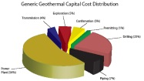
Cost/Benefit/Impact
The eleven GAP areas are subjected to a cost/benefit/impact analysis prior to any decision is made as to how the areas should be prioritized. Some are of a technical nature and can be decided rather quickly, while others require extensive process and system changes.
28

Slide 29
Tideworks TOS Review
A specific TOS review is conducted to evaluate which functions in the TOS have been adjusted, and how/if these are to be rolled back to the standard configuration (if required), as well as how such functions can be handled in locally developed systems, like the TinO or EC2 PCS.
29

Slide 30
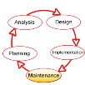
Development Program
The functions that are not TOS-essential are developed over time in local applications like TinO or EC2, in synchronization with the roll-back to the standard configuration of the TOS, possibly preceded by a pilot to allow the technical and business testing of such functions, and allow a final impact analysis prior to a full-fledged development program.
30

Slide 31
Business Workshops
Business workshops and pilots should be conducted throughout the program as partnership programs. It is suggested to initiate a “Stakeholder Partnership Group” as a core reference group, to test each area and ensure that the port and the supply chain stakeholders are jointly in agreement with the proposed changes.
31

Slide 32
Development Program
A Development Program is initiated to manage and control the activities and cost, with direct reference to the Luka Koper Senior Management and Steering Committee.
32

Slide 33
COPARN pre-check
The COPARN announcement is sent from the line operator’s shipment management system and reflects
“the contract of carriage”
agreed with the exporter. If the container is delivered at the gate with incorrect or changed information this will cause extra work, truck stows and waiting time.
Pre-Checking will avoid that

Slide 34
COREOR Import Release
The COREOR is sent to the terminal and the cargo owner with a “PIN” that is used as a “password” to identify the authorized trucker that will take delivery of the import container on behalf of the importer..
Included in the TOS and presented at the gate it has been found to be the safest way to avoid possible incorrect delivery of import containers – or even fraud.
Even better would be a pre-check combined with a VBS booking.

Slide 35
Better Yard & OPS planning
The optimal planning is that the containers are only moved twice in the yard:
DECKED and DELIVERED
All other moves are either caused by terminal adjustments or incorrect information, like change of vessel/voyage, change of first discharge port, incorrect weight etc.
A terminal move is expensive and require extra administration, communication and unnecessary delays.

Slide 36
UN / EDIFACT Messages
Message | Description
BAPLIE | Bayplan inbound – stowage plan
BAPLIE | Bayplan outbound – stowage plan
MOVINS | Stowage instructions
COPARN | Delivery notification for export container into the terminal
COPARN | Release notification for empty container out of the terminal
COPRAR | Load / discharge instructions
COARRI | Load / discharge advice
CODECO | Gate in / out advice
COREOR | Container release advice
TPFREP | Terminal performance summary report
CUSCAR | Customs Manifest
CUSRES | Customs response
VESDEP | Vessel arrival and departure advice

Slide 37
Message | Focus | Description | Sent by | Sent to
BAPLIE | Vessel | Bayplan inbound – stowage plan | Previous port or line operator or central planners | Container Terminal
BAPLIE | Vessel | Bayplan outbound – stowage plan | Container Terminal | Next port or line operator
MOVINS | Vessel | Stowage instructions | Line operator or central planners | Container Terminal
COPARN | Container | Delivery notification for export container into the terminal | Line operator | Container Terminal
COPARN | Container | Release notification for empty container out of the terminal | Line operator | Container Terminal
COPRAR | Vessel | Load / discharge instructions | Line operator | Container Terminal
COARRI | Container | Load / discharge advice | Container Terminal | Line operator
CODECO | Container | Gate in / out advice | Container Terminal | Line operator
COREOR | Container | Container release advice | Line operator | Container Terminal

